Slide 1

Assassin’s Creed 4: Black Flag
Lighting, Weather and Atmospheric Effects
Bart Wronski, 3D Programmer, Ubisoft Montreal

Slide 2


Slide 3
Background
Next-gen consoles launch title!
…but done for previous generation as well
Current-gen was dominating install-base and we cared a lot about those players
Constraints on assets duplication and extra artist work
Next-gen improvements had to be procedural

Slide 4
Presentation overview
Lighting and Global Illumination
  Improvements over Assassin’s Creed 3
  Global illumination solution
  Ambient Occlusion: temporal-supersampled SSAO
  Multi-resolution ambient occlusion
Atmospheric and weather effects
  Rain ripples and wet materials
  Screenspace reflections
  GPU simulated rain
  Volumetric fog

Slide 5
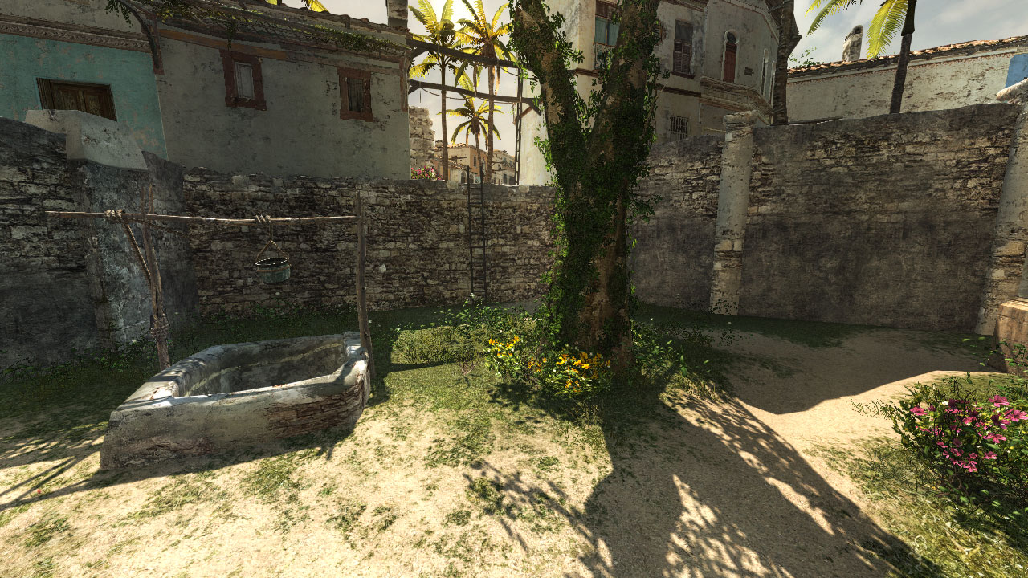
LIGHTING

Slide 6
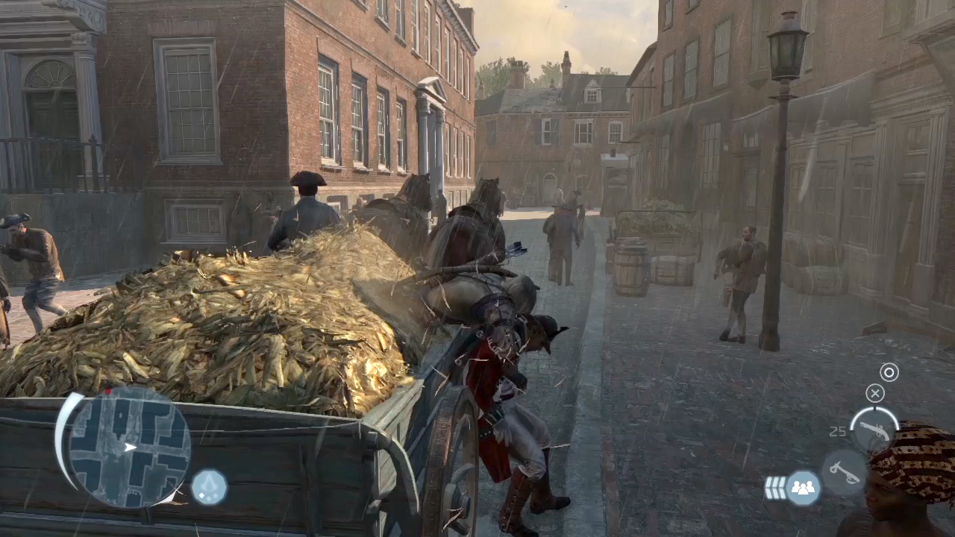
Assassin’s Creed 3 lighting – PS3 screenshot
Notes:
Notice how flat and uninteresting ambient lighting looks in shadowed areas
We lose not only sense of positional relations between objects, scene composition but also don’t see almost any normal mapping.

Slide 7
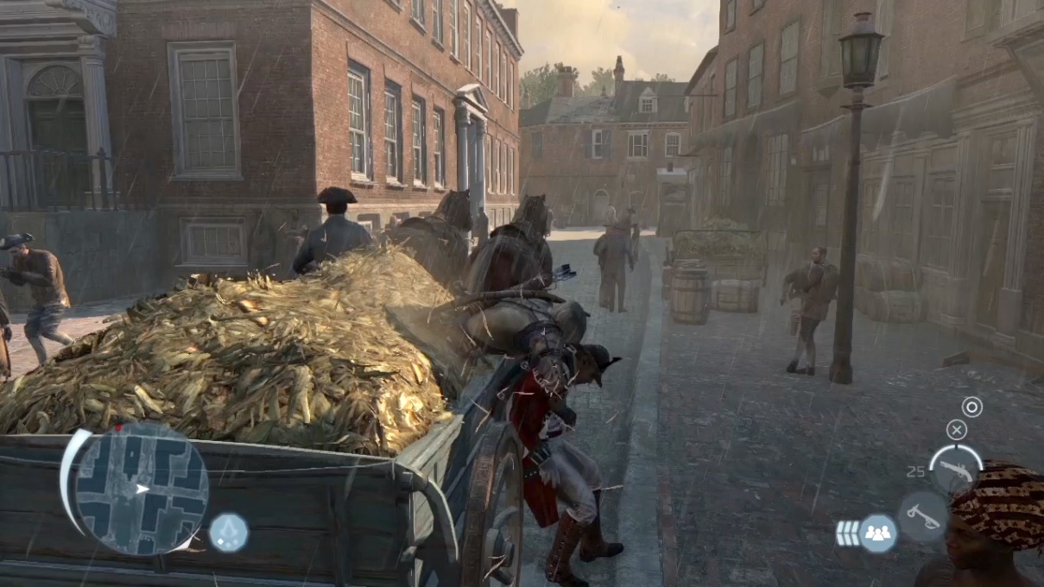
Lighting improvements
Key problems
  Overall flatness
  Lack of sense of position and directionality
  Loss of normal mapping information
Requirements
  Prototyped multiple real-time GI solutions, none of them looked good enough
  Partially baked solution
  Vast open world with sparse dense areas
  Dynamic weather / time of day
  Work on current gen (~1ms / < 1MB for GPU)
  Small impact on art pipelines

Slide 8
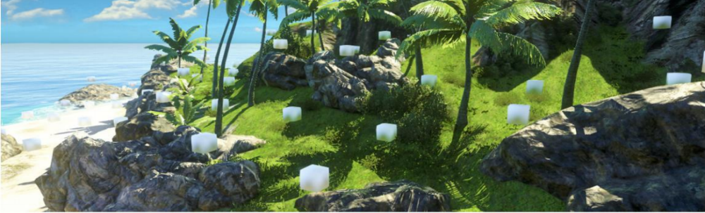
Far Cry 3 solution: Deferred Radiance Transfer Volumes
Offline
PRT based - compute radiance transfer
Store in 2nd order SH in light probes for 4 basis vectors
Compute irradiance on the CPU
Store it in volume texture
Perform deferred lighting in half res on GPU
Runtime
Notes:
We had already developed good and working technology suitable for open world games with dynamic time of day – Far Cry 3 Deferred Radiance Transfer Volumes.
We decided to give it a try and integrated it quickly despite engine differences (around 1-2 man-weeks)

Slide 9
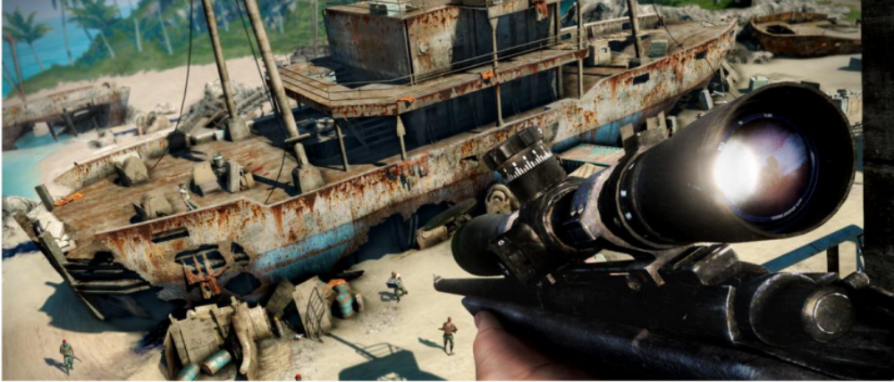
Far Cry 3 GI - Deferred Radiance Transfer Volumes
Pros
Robust and fully dynamic
Compatible with PS3&X360
Cheap on GPU (0.7ms on PS3!)
Production ready
Volumetric
Low memory and CPU cost
Cons
Low spatial resolution (4m)
Low contrast and temporal variance
Low occlusion precision
Half resolution edge artifacts
Generation/baking time
Notes:
Our early prototypes confirmed all benefits of Far Cry 3 solution.
However technique that was perfect for very sparse, forest and open areas was not high enough quality for urban environments.
We observed too low resolution and variance in GI information, bounced indirect lighting was not giving us enough contrast and didn’t change enough during day.
It was mostly because extremely low precomputed radiance transfer resolution – second order SH are not capable of storing complex visibility function.

Slide 10
New solution – background
One key light
Weather has no influence on light direction
Small amount of local lights
Notes:
Key observations:
Under sunny weather usually most perceived indirect lighting comes from main light source
We can easily split indirect lighting from sky and it’s bounces from main light component – techniques existing in our engine (like World Ambient Occlusion and SSAO) are enough to provide shadowing information
Main light trajectory not dependent on weather preset – only light color and strength depends on it
For a single GI diffuse-only bounce we can precompute and store “some” information based only on:
Albedo
Normals
Shadowing information

Slide 11
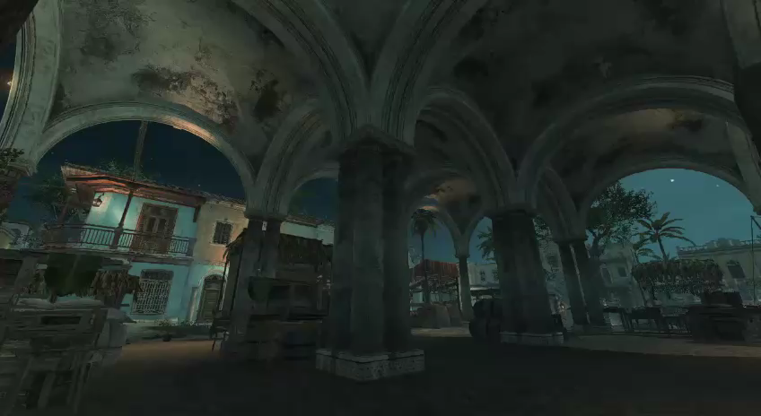
Notes:
VIDEO

Slide 12
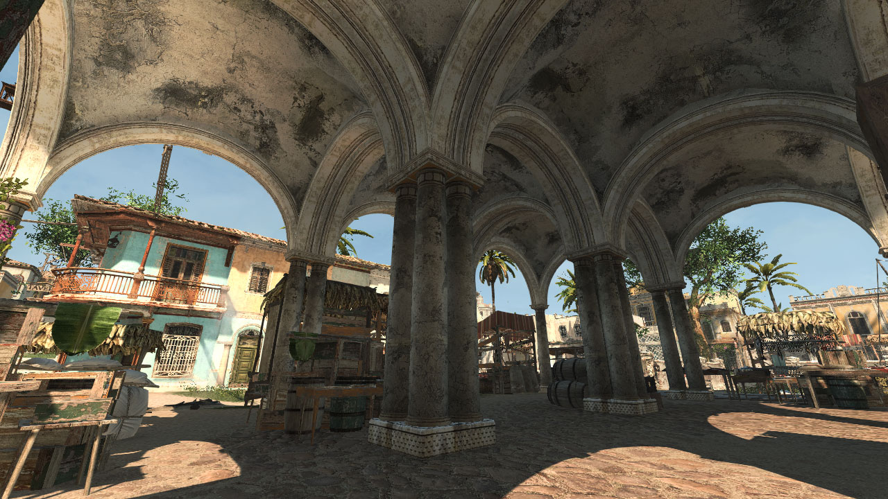
Deferred Normalized Irradiance Probes
Notes:
We developed a new solution - Deferred Normalized Irradiance Probes

Slide 13
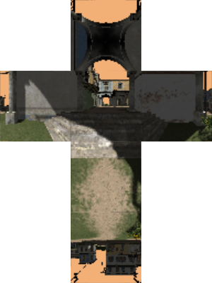
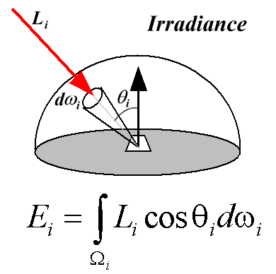

Normalized irradiance
Surrounding environment lit with neutral color
Integrate in one direction like standard irradiance
Denormalize = multiply by current light color
Irradiance image source: http://escience.anu.edu.au/lecture/cg/GlobalIllumination/irradiance.en.html
Notes:
Storing « normalized » irradiance for neutral color - WHITE, but take shadowing into account.
No multi bounce (was possible, but artists didn’t want to increase iteration times) -> use constant ambient term to fake it and avoid pitch-black areas.

Slide 14
Deferred Normalized Irradiance Probes
Offline
On GPU bake sunlight bounce irradiance
Store irradiance at 8 different hours
Compute 2D VRAM textures (many lightprobes)
De-normalize and blend irradiances
Blend out bounced lighting with height
Combine with indirect sky lighting and AO
Runtime
Notes:
First, let’s have a look at our offline rendering / baking part.
We use GPU cubemap capture and GPU convolution to calculate irradiance for four basis vectors.
GPU baker was very efficient as albedo and normals do not change with dynamic time of day, only shadowmaps. We reused big resolution shadowmaps for whole sector of 64x64 meters.
World has 2.5D structure so we stored information in 2D textures that could be compressed and later blitted using GPU

Slide 15
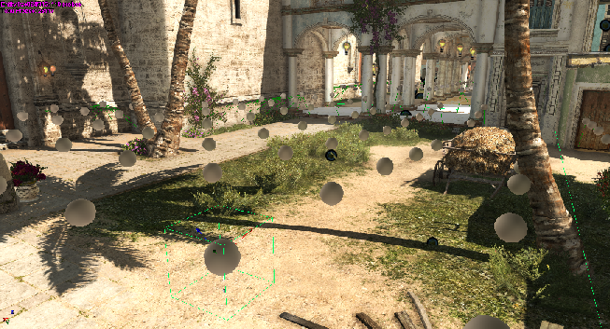
Implementation – tool side
Place probes with navmesh
Notes:
Use navmesh: trim the ones in unreachable interiors and reuse neighboring information -> Solve interpolation issue.

Slide 16
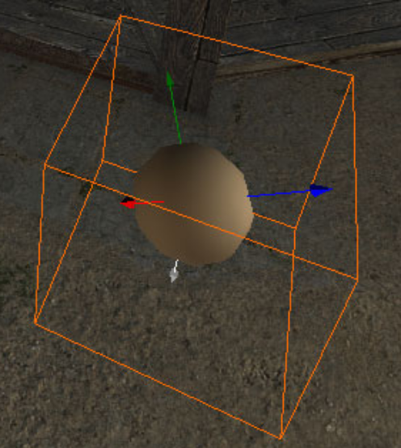
Data storage
8 key-framed values a day
8-bit RGB normalized irradiance
4 basis vectors (FC3 basis)
Uniform grid 2m x 2m
Only one layer
  2.5D world layout / structure
Notes:
Times at which we captured GI:
Midnight, 3AM, 6AM, 9AM, 12PM, 3PM, 6PM, 9PM

Slide 17
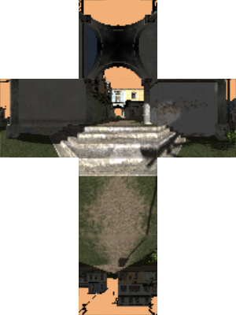
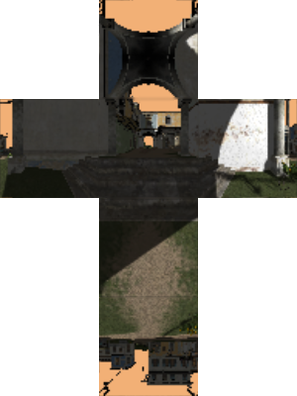
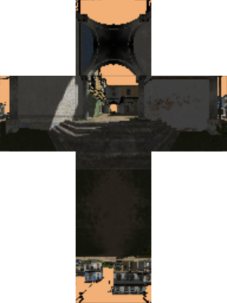
Implementation – tool side
Place probes with navmesh
For each probe, generate multiple cubemaps
Notes:
For each probe, 8 cubemaps, every 3 hours
We use a neutral, white sun in order to be able to apply weather at runtime
We have an optional ambient term because we don’t have multi bounce GI

Slide 18
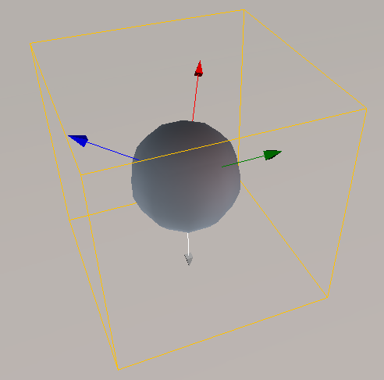
Implementation – tool side
For each cube map, compute irradiance in 4 directions, packed in 3 RGBA
Do that for all times of day
0:00
3:00
6:00
…
21:00
RRRR
GGGG
BBBB
Notes:
For each cubemap we compute 4 irradiance colors by integrating the cubemap in 4 directions, indicated by the arrow (same as FC3 basis)
Faster to do it this way to get the final ambient color (PS3 swizzling vector registers performance)
Red arrow on upper right side of the screen -> One normalized irradiance color
Put this color in Red channel of 3 different texels
Repeat the process for Green direction, blue direction, grey direction
We obtain 4 colors x 8 times of day.
We pack each channel R,G,B of the 4 directions together, into 3 RGBA channels
And we store everything in a texture

Slide 19
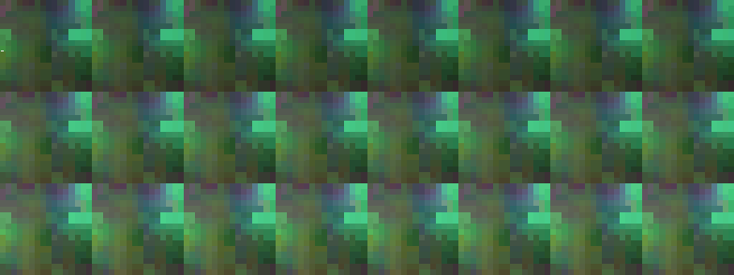
Implementation – tool side
Each Texture contains this data for 16x16 probes
0:00
3:00
6:00
9:00
12:00
15:00
18:00
21:00
16
RRRR
16
GGGG
BBBB
Notes:
Group this data in sectors -> 16x16 probes
Blinking dot represent data for one probe
Texture that is used in engine
Embedded in entity, streamed in like other resources

Slide 20

Implementation – tool side
Optimizations
Limit cubemap camera far plane (10-30m should be enough)
Re-use G-buffer between different day times
Reuse shadowmaps between multiple probes
Use only one, big in size and resolution cascade per sector
Special, simpler path for scene traversal code
Do the convolution and keep all the data on the GPU until you need to save final textures!
Notes:
To provide interactive iteration times, we needed to modify brute-force baking A LOT.
@ 60 FPS / 30 000 probes, 6 cube faces x 8 time of day = 1 440 000 renders -> 400 mn (6h40)
Unacceptable!
(notes: before navmesh spawning optimization, we had 110 000 probes, so we would have needed ~ 26 hours to compute everything …)
Some optimizations notes:
- Less objects -> camera Far @ 15 meters
- Reuse Gbuffer for 8 times of day
- Same shadow maps shared by sector of probes
- One Cascade -> contains all sector
- Frustum Culling bottleneck -> custom traversal, 2d position and distance based
- Make sure CPU won’t stall when locking GPU textures -> use round robin of multiple queries

Slide 21
Deferred Normalized Irradiance Probes
Offline
On GPU bake sunlight bounce irradiance
Store irradiance at 8 different hours
Compute 2D VRAM textures (many lightprobes)
De-normalize and blend irradiances
Blend out bounced lighting with height
Combine with indirect sky lighting and AO
Runtime

Slide 22
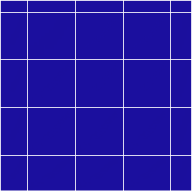





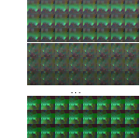













Implementation – runtime
Generate on GPU denormalized data in 3 textures
Blit sectors surrounding camera: select slice / apply sun color
Notes:
Denormalization done on GPU (pixel shader taking 0.1ms on ps3)
We use the irradiance texture generated offline
Based on the current time of day, and camera location, sample the appropriate pixels in each probe area
Interpolate to a neutral value based on XY distance of the pixel from from camera

Slide 23

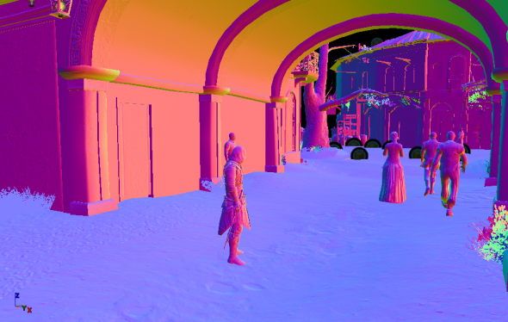


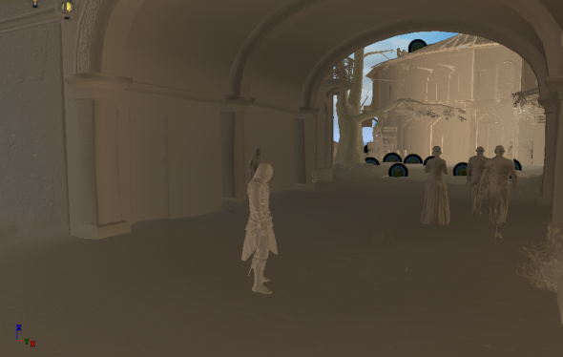
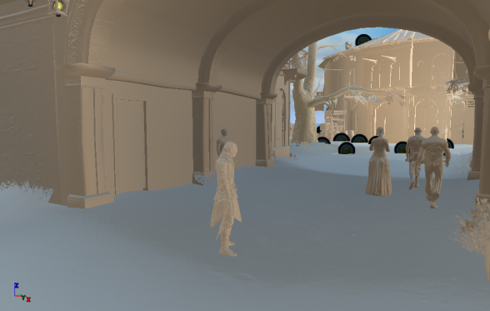
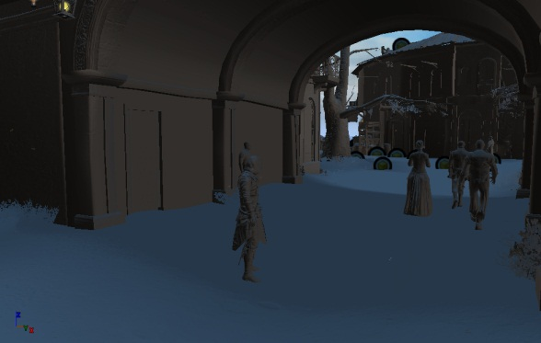
Implementation – runtime
Notes:
We use these runtime irradiance textures to compute our indirect lighting: the 4 irradiance get interpolated based on the pixel normal, and we have a height texture that allows us to fadeout vertically to a neutral color
Right side of the slide: sky lighting – ambient cube combined with normals + world ambient occlusion data simulating occlusion from high buildings and other “big” geometric features
Center: combined ambient (without SSAO)

Slide 24
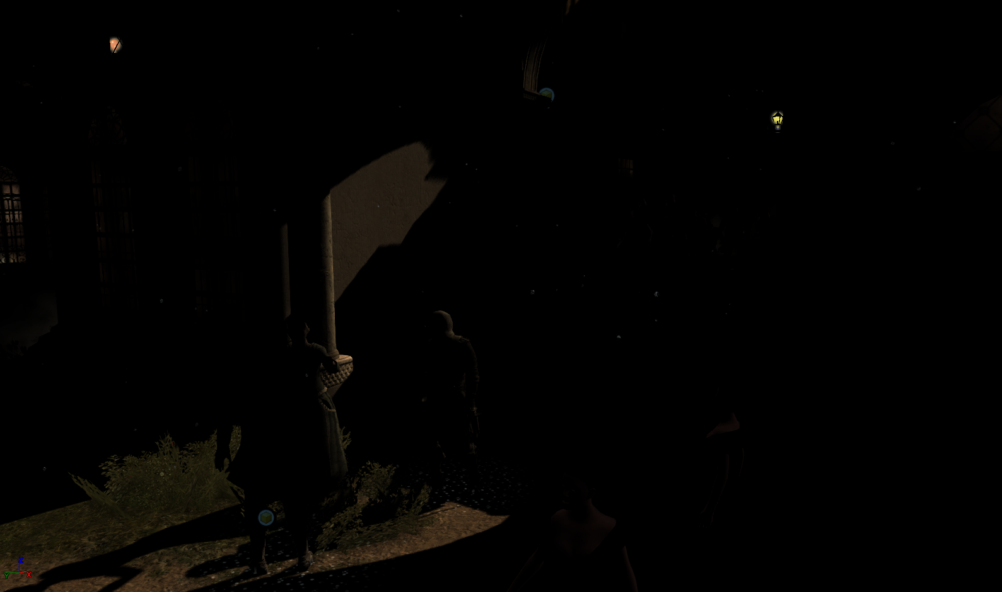
Notes:
Image decomposition:
Direct lighting

Slide 25
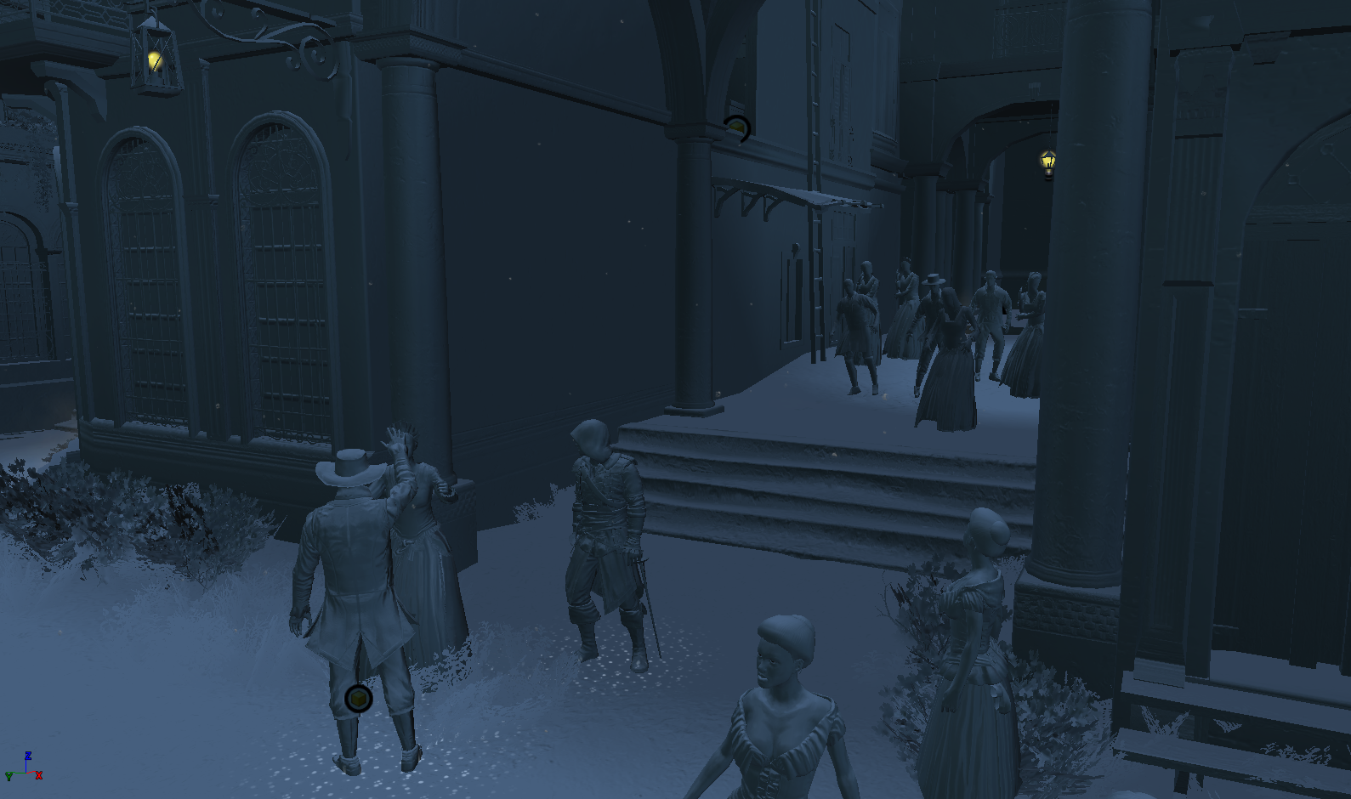
Notes:
Sky lighting + world AO

Slide 26
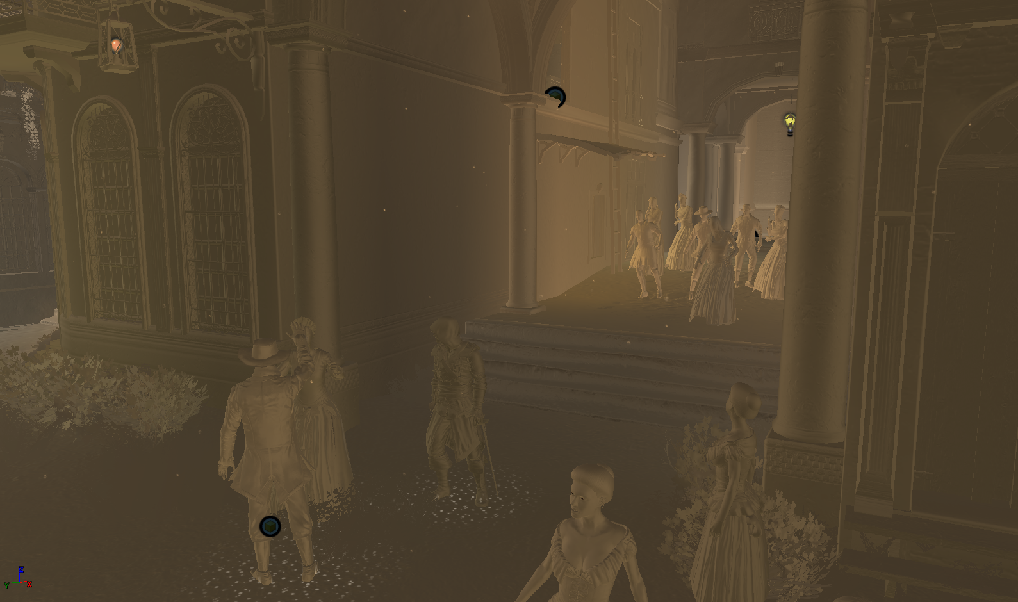
Notes:
Indirect lighting

Slide 27
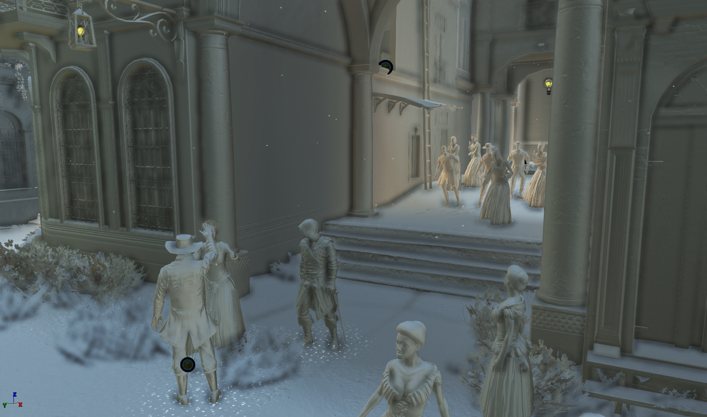
Notes:
Combined, with SSAO (PS3 SSAO version!)

Slide 28
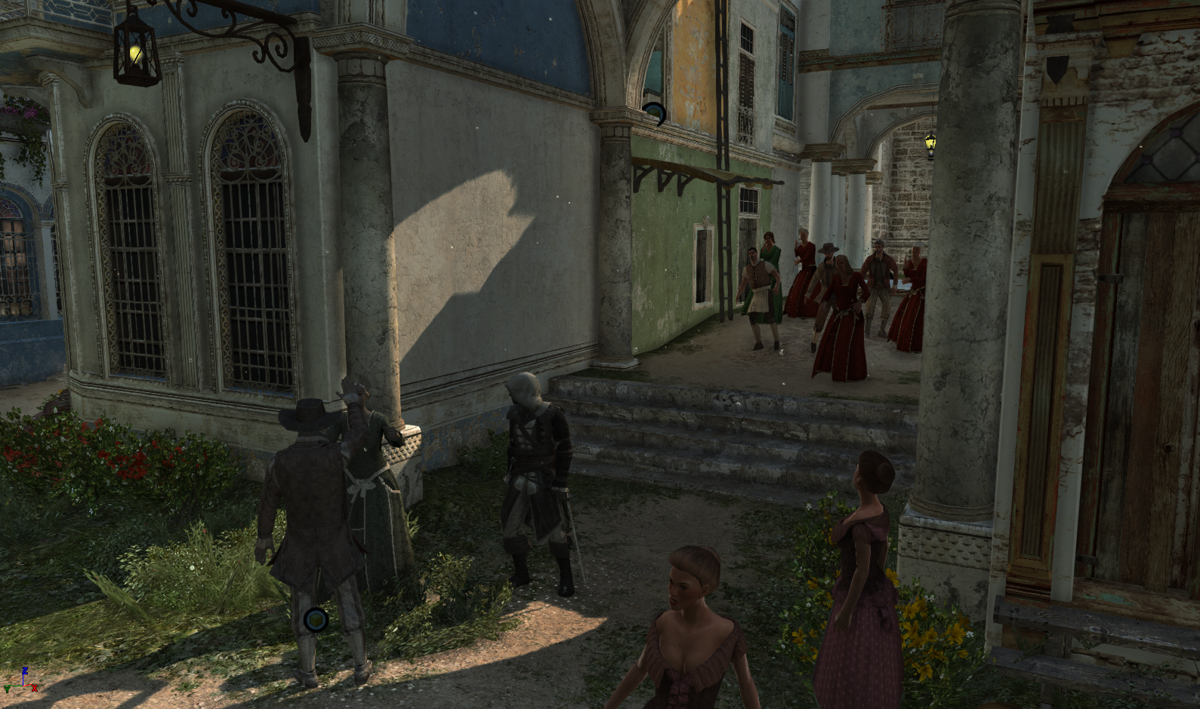
Notes:
Combined, SSAO, albedo applied

Slide 29
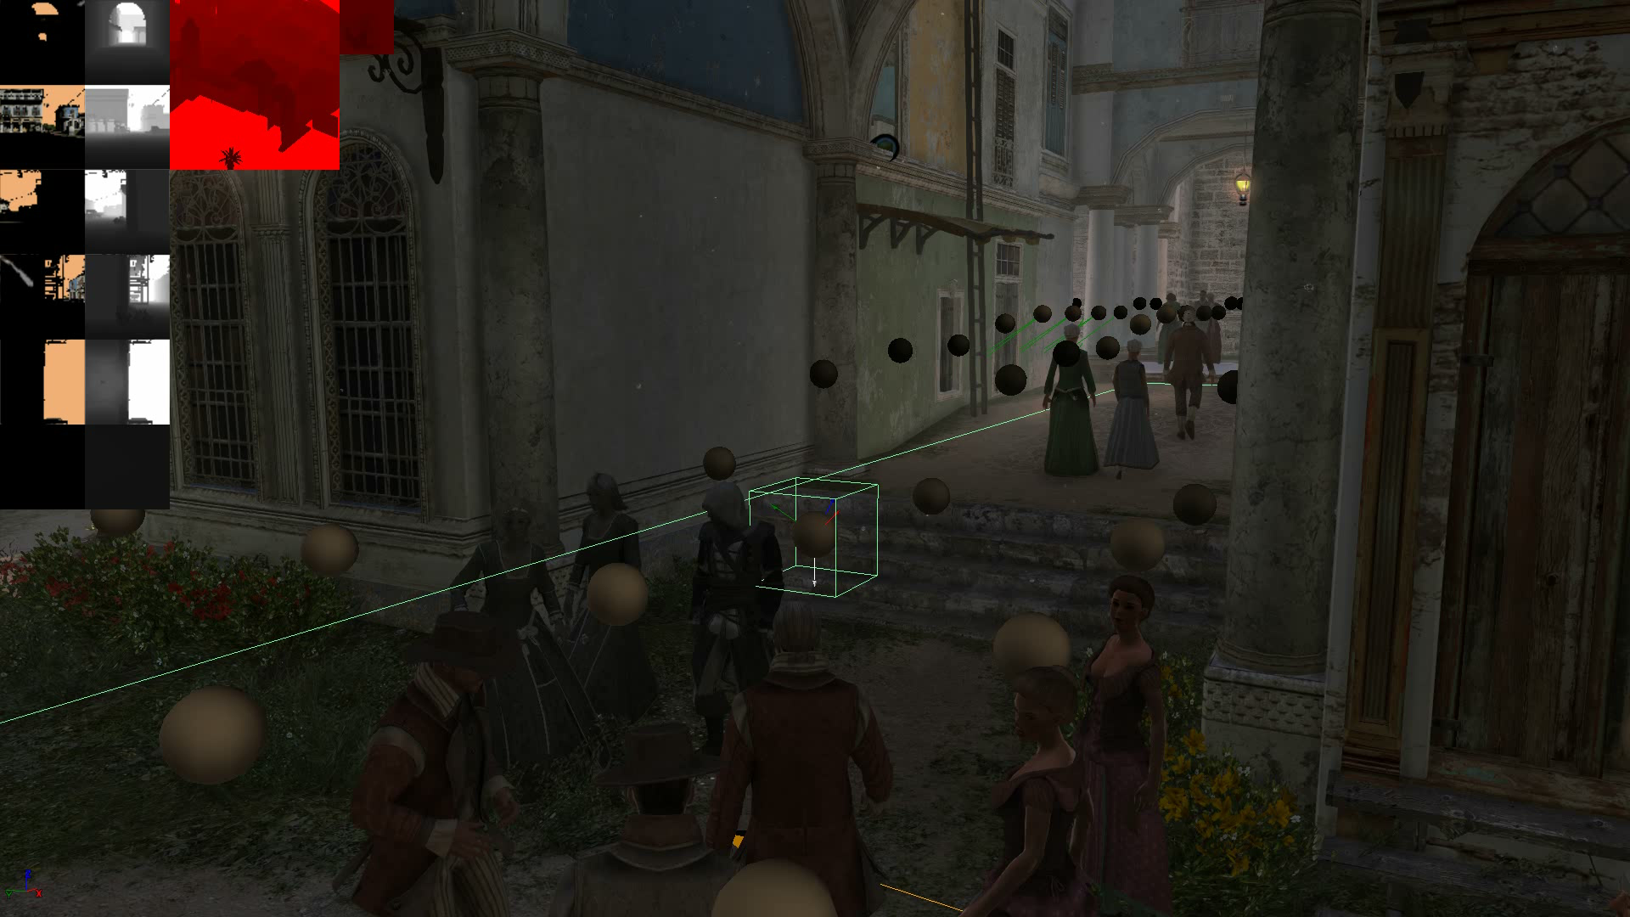

Slide 30
Benchmarks and summary
GPU performance cost | 1.2ms fullscreen pass - PS3
Memory cost (probe data) | 600kb (VRAM only)
Memory cost (render targets) | 56kb
CPU cost | 0.6ms (amortized)
Num probes in Havana bruteforce | ~110 000
Num probes in Havana trimmed | ~30 000
Full baking time for Havana | 8 minutes (nVidia GTX 680, one machine)
Notes:
Performance cost:
PS3&X360 Without stencil marking optimization (sky, ocean) 1.2ms for fullscreen pass
When combined with calculating screen space sun shadow mask (cascade selection, PCF filtering) in the same pass, around 1.8ms – some cost got amortized
On next gen and PC cost of bounce calculations is negligible compared to shadow mask that it is computed with
Memory cost:
We load 25 sectors around the player, all of them store data as 16x16 probes for 8 times of day and irradiance in 4 directions:
25 RGBA textures sized 48x128 = 600kb of VRAM
We thought about DXT5 compression or streaming just required 2 times of day, but cost is almost negligible so we didn’t need to pursue it
CPU performance:
We needed to uncompress world height data available for gameplay and placed in RAM memory. We optimized it a lot using vector intrinsics, but still cost was non-negligible.
In the end it cost us ~0.6ms for full update. Fortunately, some parts we didn’t have to do – as we supported texel snapping, we could update height data only when it was needed.
Number of probes:
When using bruteforce placement on highest available spot in the world aligned to grid, we had around 110 000 probes per typical game world.
When we used navigation mesh to place probes only on areas accessible to the player, it got down to 30 000.
Full baking time:
On single machine equipped with nVidia GTX 680, full baking time for whole world and all 8 times of day was around 8 minutes. Therefore it didn’t require any distribution over whole world, technical art directors and lighting artists were able to do it on demand.
We also added option to re-bake some probes or have continuous baking in background in editor (probes visible in the viewport were constantly rebaked in the background – almost no performance impact)

Slide 31
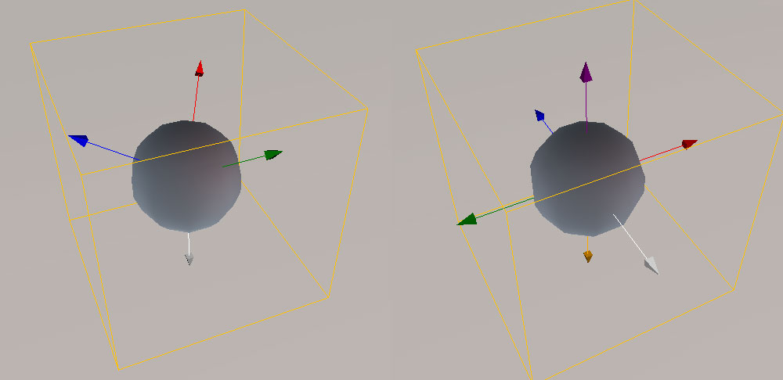
Limitations and future improvements
Current basis vs typical cubemap basis
Lack of side bounce
Ground color bleeding
Basis not normalized
Lack of energy conservation ☹
Notes:
We wanted to change irradiance storage basis to something more accurate one.
HL2 basis with added “wrap-around” vector pointing down - didn’t work very well.
The weights were not always normalized, resulting in brighter color in some directions.
There was lots of ground color bleeding to the sides.

Slide 32
Future work
Change basis to more accurate one
Increase probe density in X/Y/Z
Use real HDR irradiance with sky lighting
Multiple bounces
Update closest probes in the runtime (cheap, GPU-only code!)
Notes:
Increase probe density / Have multiple layers in height axis instead of blending it out with height
Instead of storing “normalized” irradiance, use multiple weather presets
Handle multiple bounces. Had some support but didn’t use it in the final result – iteration times. We were also not being completely energy conserving (storage basis) – adding light to the scene instead of diffusing it.
Update some probes on GPU -> cache Gbuffer and light env map @ runtime -> distribute probes on multiple frames

Slide 33
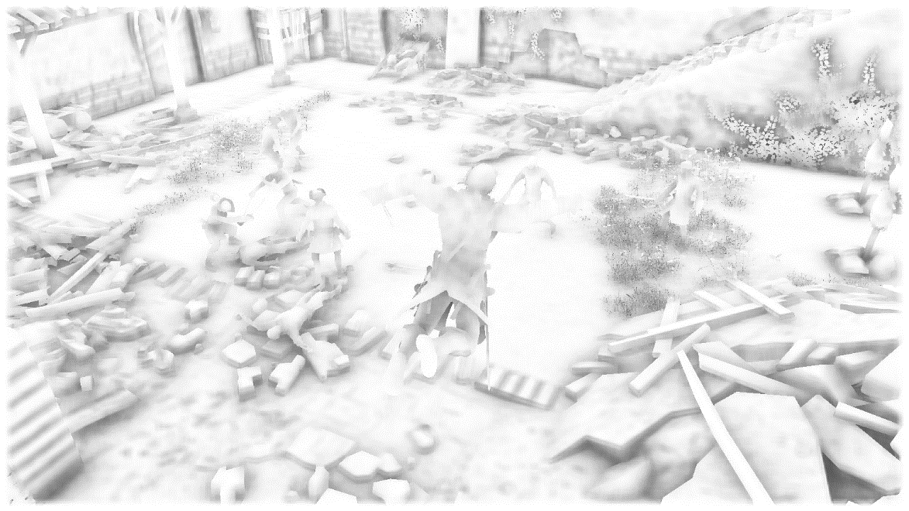
Ambient Occlusion
Notes:
Ambient occlusion

Slide 34
Scalable Ambient Obscurance
Extensions to algorithm by McGuire et al
Great performance - ~1.6ms full res on consoles with filtering and applying
Large radius ~1.5m, takes normal mapping into account
Our extension – temporal supersampling
Different than existing approaches by changing sampling pattern every frame
Rotate AO samples spiral in 3 distinct patterns every frame (120 degrees)
Effectively the triple number of samples!
Blend and accumulate frames, reject on depth difference

Slide 35
SSAO sample number increase by using temporal supersampling
Notes:
Example pattern (not final one!) rotated 3 times and accumulated over time to triple number of effective samples

Slide 36
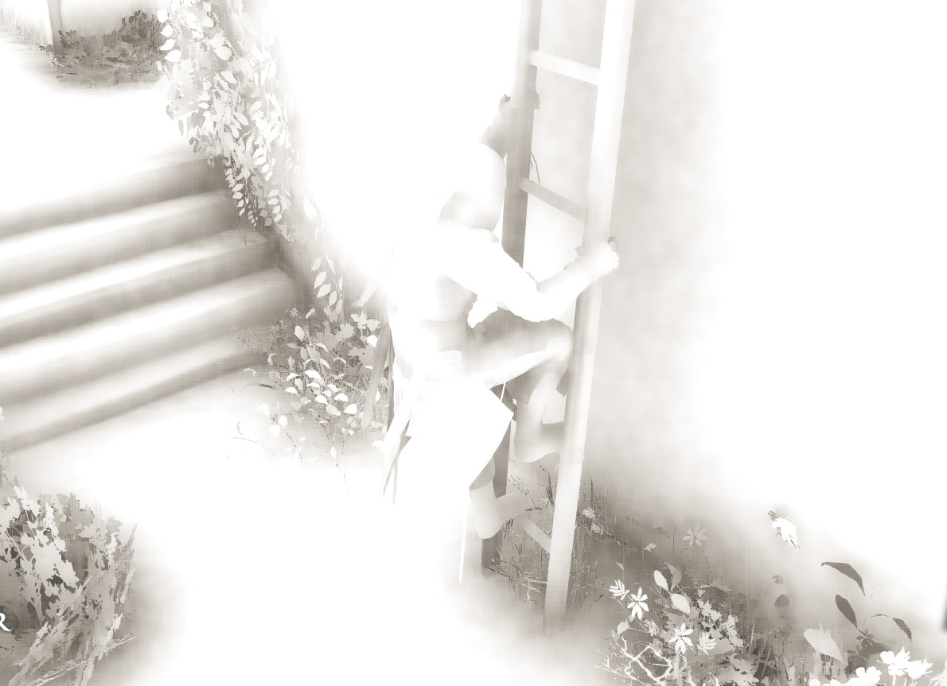
No temporal

Slide 37

Temporal

Slide 38
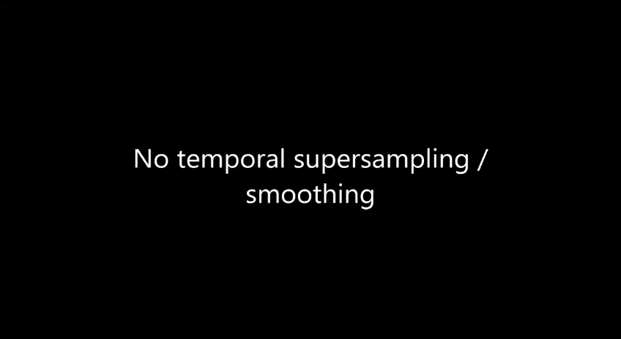

Slide 39
Ambient occlusion
SSAO is not enough to represent sky lighting occlusion…
Even multi-res approaches won’t catch all occlusion
Idea – separate ambient occlusion into multiple frequency bands
Every frequency band calculated with a different algorithm!

Slide 40
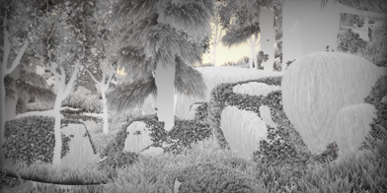
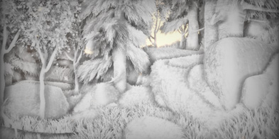

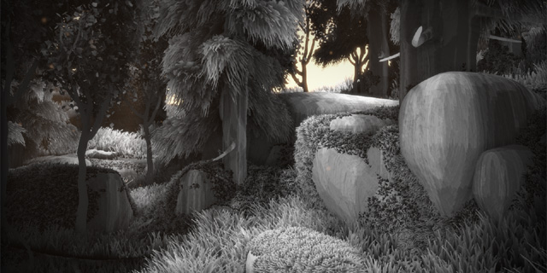
Multi-resolution ambient occlusion
Example by Inigo Quilez
Source: http://www.iquilezles.org/www/articles/multiresaocc/multiresaocc.htm
Notes:
Great write-up and example to existing technique by Inigo Quilez.

Slide 41
World Ambient Occlusion
Needed large scale sky occlusion for direct sky lighting from buildings and trees
World Ambient Occlusion
Technique developed for Assassin’s Creed 3
See Jean-Francois St-Amour talk from GDC 2013!

Slide 42
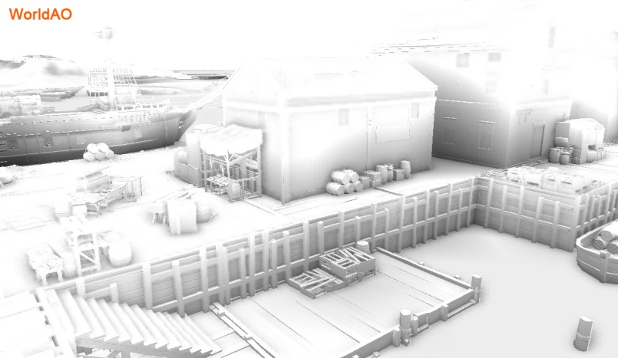
Notes:
Looks of “World ambient occlusion” in Assassin’s Creed 3

Slide 43
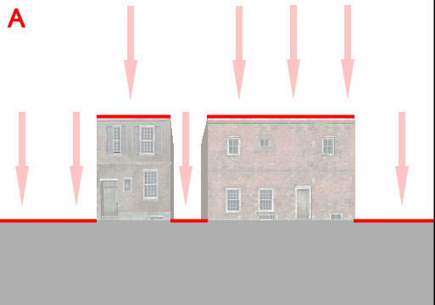
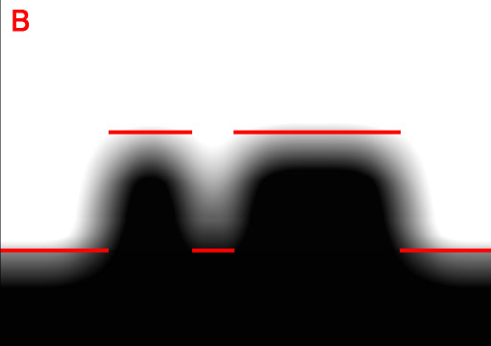
World Ambient Occlusion
Offline
  render scene depth from top
  7x7 Gaussian blur on the depth
At runtime:
  Sample World AO to get an estimated occluder height
  sample offset by XY normal
  Apply AO to sky ambient lighting only
  Baked sun bounce irradiance already contains this frequency of information!
Notes:
Algorithm very approximate and requires artists to tweak some “magic values”, but extremely cheap to evaluate and quite robust.
…As long as your scene can be approximated by heightfield!

Slide 44
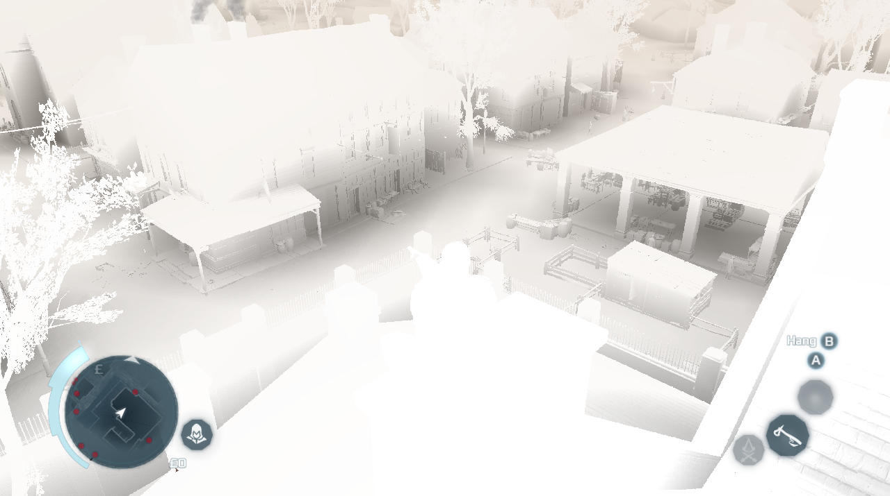
Notes:
Looks of “World ambient occlusion” in Assassin’s Creed 3

Slide 45
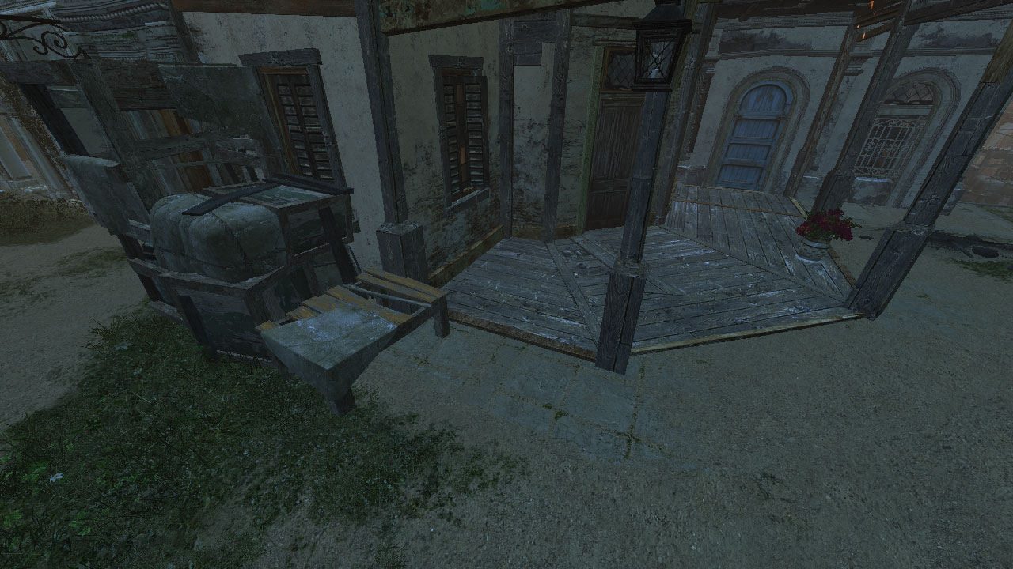
Notes:
Again some results screenshots.
Old AC3 technique – just the ambient cube, without the WorldAO.
Screenshot from around 7-8PM, because of very low sun elevation this part of town is completely in shadow.
Effect – uninteresting, artificial look. Loss of almost all normal mapping and lighting variety.
It is also too dark, but brighter values would result in even flatter look.

Slide 46
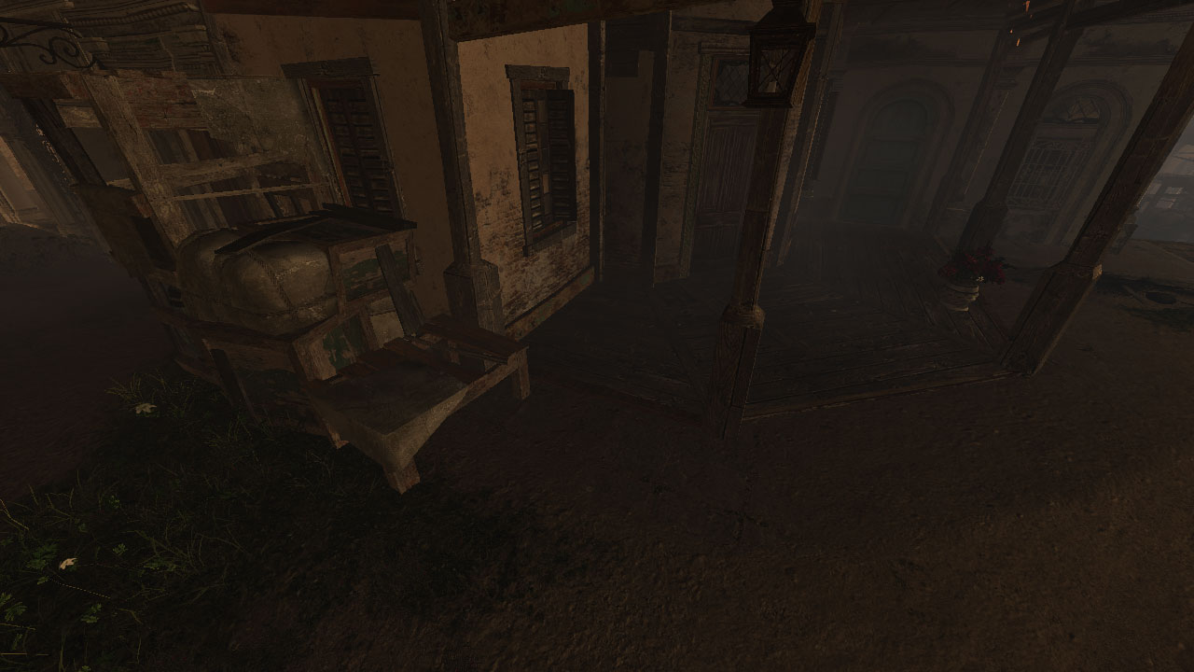
Notes:
This is how our bounced lighting looks like. We get light bounce from proper direction with proper shadowing. Lighting varies not only with direction, but also with world position.
We start to see some normal mapping on the ground.

Slide 47
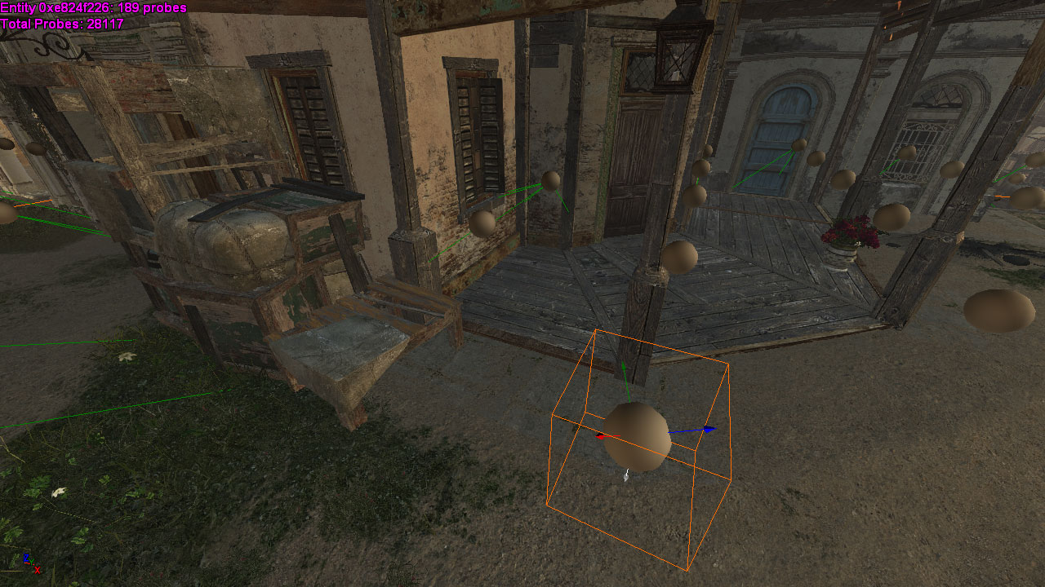
Notes:
Composed scene of bounced lighting and regular sky light represented by lighting cube. Scene rich, colorful with lots of light variation and visible normal maps.

Slide 48
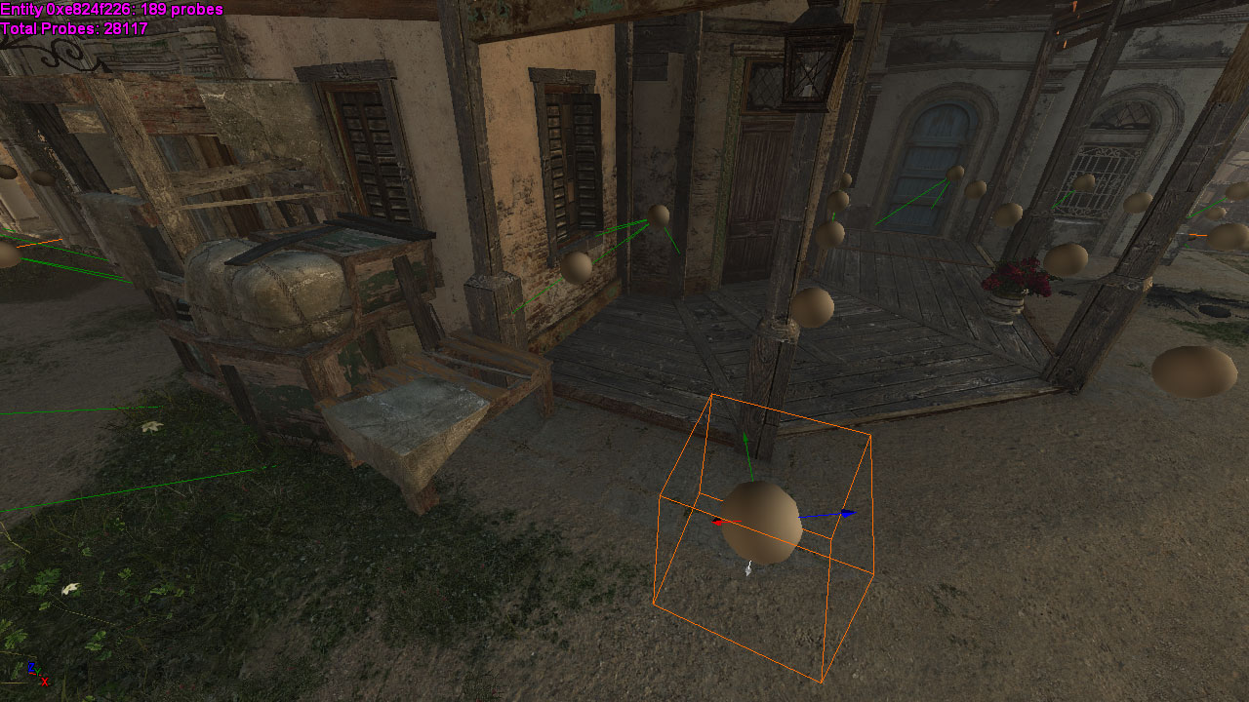
Notes:
Final scene with World AO and SSAO applied.
To read World AO technique description, see GDC 2013 presentation by Jean-Francois St-Amour called “Rendering of Assassin’s Creed 3”
We present multiple probes and their placement (every 2m).
Probes are placed automatically using nav-mesh – green lines represent probes missing due to collision – they get replaced by the probe connected to them.
We found no errors using such interpolation and probe replacement.
Also this screenshot shows our irradiance vector basis. This is unmodified Far Cry 3 basis – three vectors pointing up (like in Half Life 2 basis) and additional, fourth wrap-around vector responsible for lighting bounced from the ground.

Slide 49
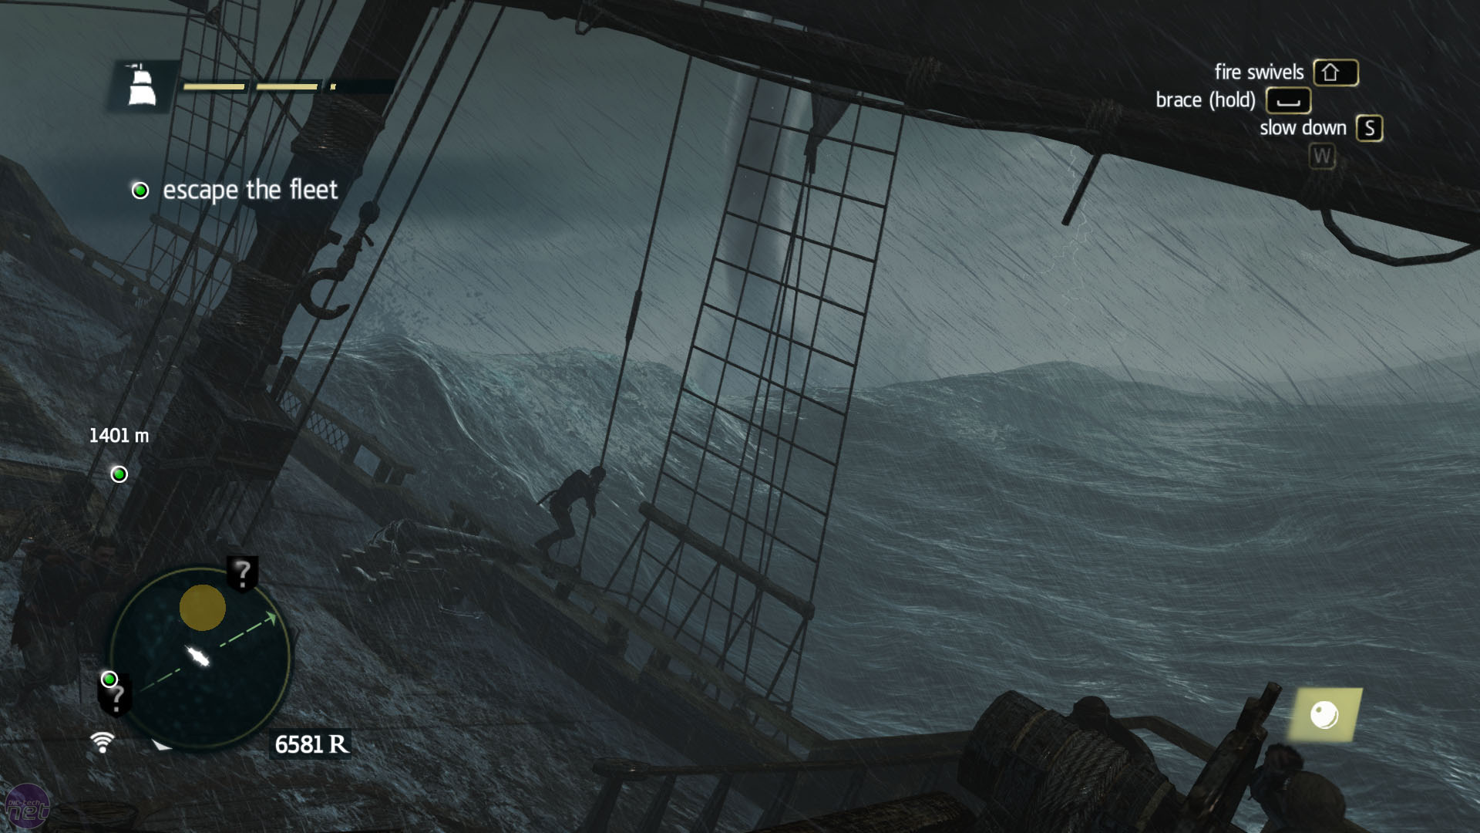
Atmospheric and weather effects

Slide 50
Atmospheric effects
Caribbean tropical climate extremely unpredictable
Goes from dusty and dry to showers and storms within minutes
Already had coherent and robust weather system from AC3
Need for new cool, next-gen procedural atmospheric effects!

Slide 51
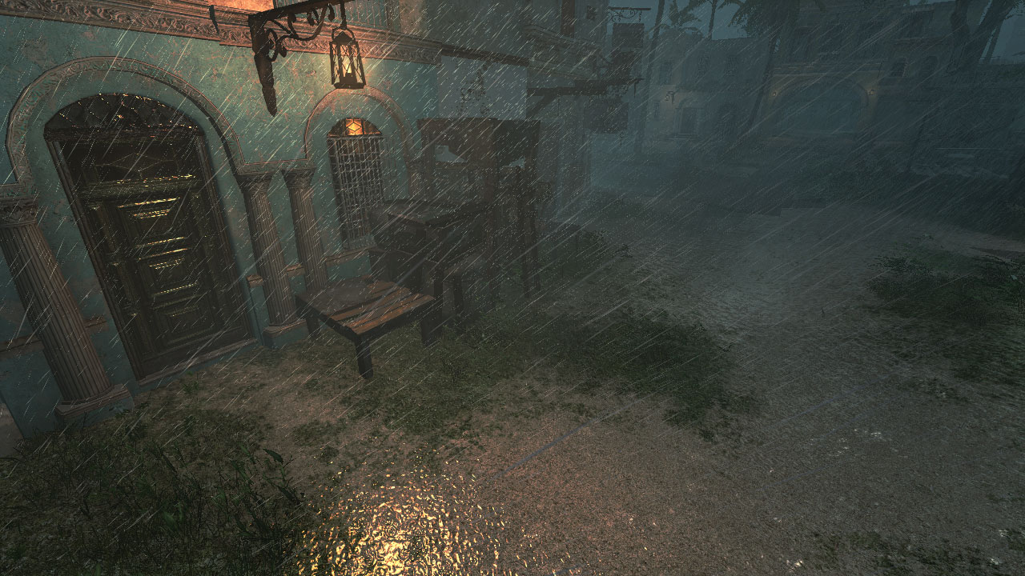
GPU Procedural Rain
Rain ripples

Slide 52

No ripples

Slide 53

Ripples

Slide 54
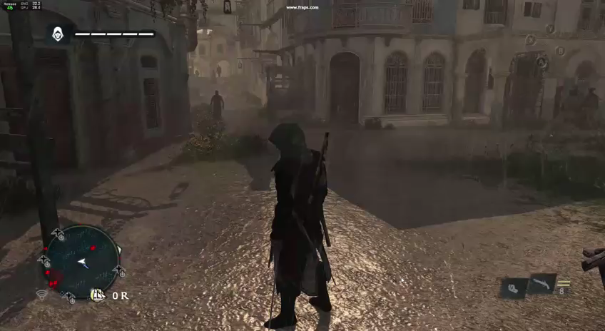

Slide 55


Rain ripples
CS: Spawn and evolve rain ripples
PS: Draw rain ripples into signed heighfield texture
PS: Calculate heightfield derivatives
Field | Type
Position | float2
Life | float
Max life | float
Strength | float
Max radius | float
Updated rain ripple structure
256x256 signed R8 texture
256x256 signed R8G8 texture

Slide 56
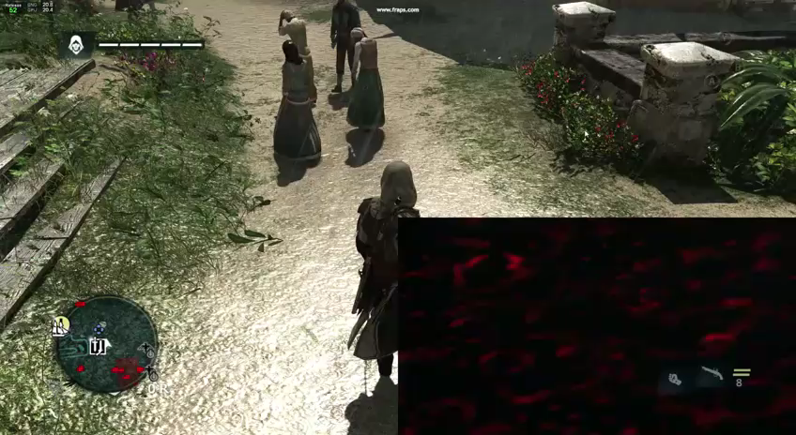

Slide 57
Drawing rain ripples – geometry multiplication using geometry shaders

Slide 58
Rain ripples
Single pass to apply it on screen and perturb existing normals
Wrap texture around in world space
World AO is sky occlusion…
… so use it for rain occlusion = no additional runtime cost
Rain ripples update and texture generation cost ~0.2ms
Perturbing normals can be a separate pass (~0.4ms) or combined with lighting (pipelined well and “free”!)

Slide 59
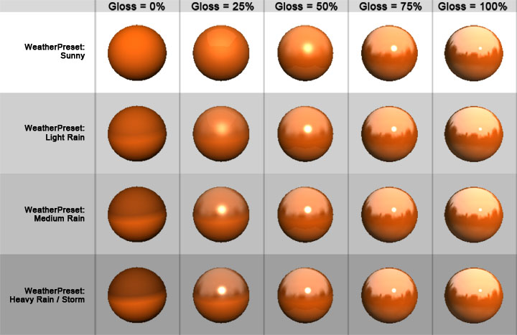
Wet materials
Surface wetness stored in G-buffer
“Baked” for wet areas or modified dynamically by weather
Use it during lighting pass to update gloss and albedo
Increase the gloss, darken the albedo
Same technique used in Assassin’s Creed 3
..but enhanced using screenspace reflections!

Slide 60

No screen-space reflections

Slide 61

Screen-space reflections
Notes:
Notice how screen-space reflections add wetness impression and again improve composition of the whole scene
Especially interesting is how on-screen objects provided proper sky occlusion

Slide 62
GPU Procedural Rain
Rain drops
Notes:
On the next gen consoles, we wanted to use compute and geometry shaders to achieve extremely high volume 3d rain effect. It was supposed to be fully procedural, but art-driven effect.

Slide 63
Procedural rain drops
Fully GPU-driven – compute and geometry shaders
Simulate 3x3 grid of rain clusters around the camera
  Avoids “popping” of new rain drops and guarantees uniform distribution
Render only visible clusters (CPU culling)
Clusters simulated and rendered
Clusters simulated
Notes:
Rain drop system – simulation and rendering
Due to rather simple nature of rain simulation (but massive particle count), we decided to keep whole simulation on GPU.
Rain behavior and physics were simulated using compute shaders and then later expanded from points to target rain geometry using geometry shaders.
To avoid “popping” of rain drops but still have decent performance, we have 9 active rain clusters (3x3 grid), centered around the camera. Rain is simulated in all of them, but only ones that are intersecting the camera frustum are being rendered.

Slide 64
Procedural rain simulation
Multiple factors taken into account
  Random rain drop mass and size
  Wind and gravity
  Rain-map for simple sky occlusion
    Top-down close range 128x128 “shadowmap”
Notes:
We take multiple factors into account during the simulation

Slide 65

Rain map
Notes:
Notice how extremely low resolution was the rain map and it lacked any dynamic objects or even ground!
…but its rendering cost was negligible.

Slide 66
Procedural rain simulation
Rain map used together with WorldAO for rain occlusion
  (different range and precision)
Screen-space collisions with depth buffer
Spawning new particles on collision
  Simulating bounced rain drops

Slide 67
GPU Procedural Rain update scheme
CS: Spawn point sprites
CS: Spawn point sprites
CS: Update/simulate point sprites
read/write structured buffers
CS: Update/simulate point sprites
VS/GS/PS: Expand point sprites to particles and draw
VS/GS/PS: Expand point sprites to particles and draw
Frame N
Frame N+1
Notes:
Rain update process:
Using rain map as occlusion information, we spawn some new rain drops at random positions on top of each cluster and append it to previous frames buffer with rain drops using a compute shader.
Update information about rain drops using their velocity, mass and wind information. We also calculate screen-space precise collision to determine which rain drops are colliding with the scene and spawn splashes instead. Every splash is composed from 6 wider rain drops that die out very quickly.
We draw rain drops using geometry shaders to expand points to sprites.
Rain point sprite buffers from given frame are used in the following frame.
Information from Nth frame will be used in the N+1th frame rain drop system update to keep the simulation continous.

Slide 68

Notes:
Video of bounced rain particles – exaggerated

Slide 69
Rain performance
CS Particle update cost negligible
Possible to implement complex update logic
Some features (“true” random()) are tricky
Move more particle systems to the GPU
Didn’t really need to optimize any of CS shaders
Geometry Shaders were huge performance bottleneck ☹
CS: Update rain drops (up to 320k particles) | <0.1ms
CS: Screenspace collision | 0.2ms
CS: Update bounced drops | <0.05ms
GS/VS/PS: Draw rain drops | 0.4-4.0ms
Notes:
It turned out that moving particles update to the GPU was a good decision:
Compute shaders are capable of updating huge amount of particles in negligible time. We were updating even not visible particles (clusters behind the camera) and the performance was very good. We avoided multiple CPU/GPU sync points like fetching the rainmap, spawning rain splashes on the CPU, updating the dynamic resources etc.
You can implement even very complex logic in compute shader, with branches etc. but some features are tricky. For example spawning new particles on particle death requires implementing additional CS passes. Also getting good random numbers in CS is not easy – we prepared a buffer with precomputed random numbers.
It is definitely worth investigating moving more particle system simulation to GPU to offload the CPU.
We didn’t need to optimize any of our compute shaders
Geometry shaders turned out to be a performance bottleneck. While we saved lots of memory bandwidth by simulating rain drops as points in the CS, the need to expand them in GS turned out to consume lots of GPU time and we needed to optimize it heavily. Rain without those optimizations was taking up to 20ms!

Slide 70
Geometry shader optimizations
Minimize memory processed and generated by GS
  Minimize number of generated vertices
  Minimize input/output vertex size
  Implement GPU frustum/occlusion culling in GS
…but if you don’t have to, just don’t use them!
Change for indexed draw call with manual instancing / fetching
Better performance, less shader stages
Notes:
Geometry shaders increase bandwidth usage a lot - all generated data must pass through memory.
We found out that it is beneficial to:
Minimize both maximum and actual number of generated vertices from a GS.
Minimize output and output vertex size. Some fields that are redundant can be safely removed and calculations moved to the PS. If they are relatively simple they will be scheduled better on the per-pixel level. Sometimes it is even better to fetch such value from global memory (constant/instance buffer).
It is usually trivial to implement some sort of frustum/occlusion culling in the GS. We found even doubled performance on this stage just by doing it.
Early out branches seem to not add any significant performance overhead and can save a lot of generated bandwidth.
As AMD recommends, it would still be much better to avoid any GS when not necessary… And do manual, vertex shader based instancing and instance fetching

Slide 71
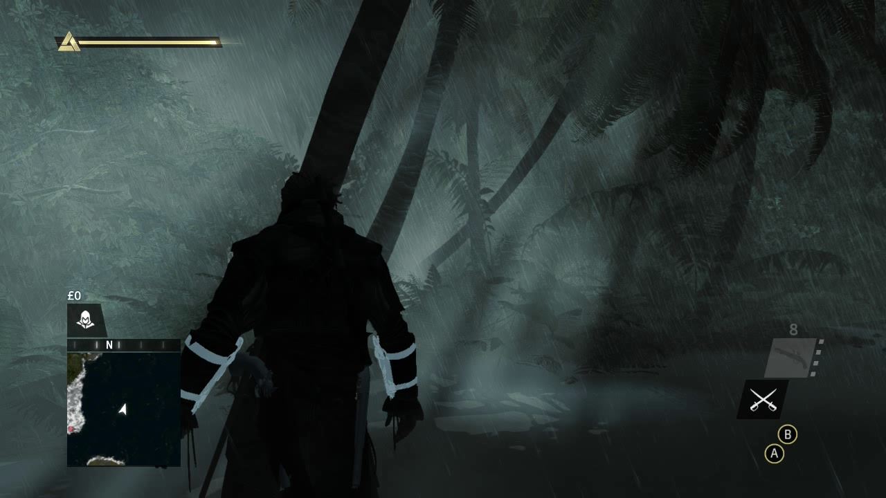
Volumetric Fog
Notes:
Technique we called internally a “volumetric fog” is in fact simulation of various and different atmospheric phenomena:
Fog, mist, haze
“God rays”
Light shafts
Dusty/wet air
Volumetric shadows
But all of them happen because of single physical phenomenon - light in- and out- scattering!

Slide 72
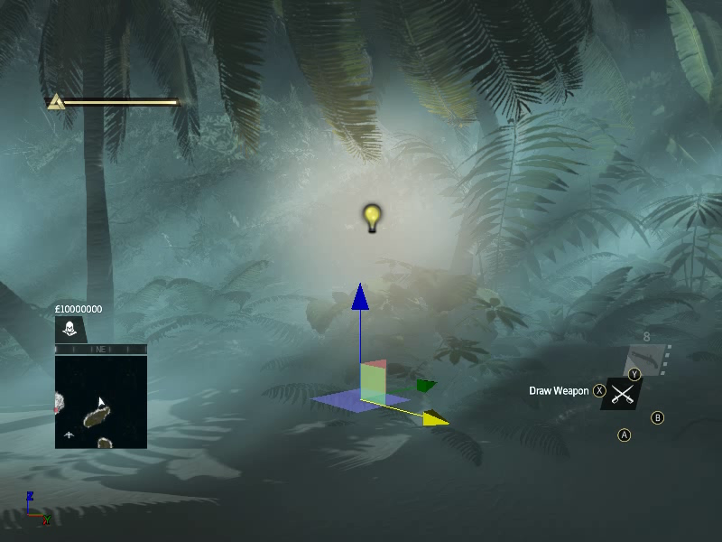
Notes:
It worked coherently, correctly and perfectly with multiple light sources

Slide 73


Slide 74
Volumetric fog
Works great for fog, mist and haze in humid climate
Perfectly complements rain storm effect (procedural animation)
Possible to simulate all atmospheric scattering phenomena
Light shafts and multiple light sources
1.1ms total on consoles!
…for implementation details see my GDC 2014 talk!
Notes:
Summary
Effect compatible with deferred and forward – can be computed even asynchronously (PS4) as soon as shadow maps are available – doesn’t depend on scene geometry
Any number of transparent layers or particles – cost of applying it in final shader is just cost of one tex3D fetch + one lerp function!
Very cheap with fixed cost for accumulation and scattering part – the same on 720p as well as 4k!
Density and lighting can be tweaked independently and changed completely
For implementation details, see my GDC 2014 talk!

Slide 75


Slide 76


Slide 77
Credits
Alexandre Lahaise | Michel Bouchard
Benjamin Goldstein | Mickael Gilabert
Benjamin Rouveyrol | Nicolas Vibert
Benoit Miller | Thierry Carle
John Huelin | Typhaine Le Gallo
Lionel Berenguier | Wei Xiang
Luc Poirier

Slide 78
Special thanks
Benjamin Rouveyrol for materials for GI slides
Rest of GI Team: Benjamin Rouveyrol, John Huelin and Mickael Gilabert
Wei Xiang for initial implementation of rain
Assassin’s Creed 4 technical art directors: Danny Oros, Guillaume Lefebvre, Philippe Ringuette-Angrignon, Philippe Trarieux, Sebastien Larrue

Slide 79
Questions?
Contact me!
Email: bartlomiej.wronski@ubisoft.com
Twitter: @BartWronsk
Slides on my blog
www.bartwronski.com

Slide 80
References
Gilabert and Stefanov “Deferred Radiance Transfer Volumes – Global Illumination in Far Cry 3”, GDC 2012
Mitchell, “Shading in Valve’s Source Engine”, SIGGRAPH 2006
Sloan et al, “Precomputed Radiance Transfer for Real-Time Rendering in Dynamic, Low-Frequency Lighting Environments”, SIGGRAPH 2002
Quilez, post aboot Multi-resolution ambient occlusion http://www.iquilezles.org/www/articles/multiresaocc/multiresaocc.htm
St-Amour, “Rendering Assassin's Creed III”, GDC 2013
Hoffman, “Rendering Outdoor Light Scattering in Real Time”, GDC 2002
Kaplanyan, “Light Propagation Volumes”, Siggraph 2009
Myers, “Variance Shadow Mapping”, NVIDIA Corporation
Annen et al, “Exponential Shadow Maps”, Hasselt University
Andersson and Bavoil, “Stable SSAO in Battlefield 3 with Selective Temporal Filtering”
Smedberg and Wright, “Rendering Techniques in GEARS OF WAR 2”
Bilodeau, “Vertex Shader Tricks”
Wronski, “Assassin’s Creed 4 – road to next-gen graphics”, GDC 2014

